Slide 1
Multi-Armed Bandit
Sanjay Hariharan, Sunith Suresh, Lin Xiao, Ilan Man

Slide 2
Exploration vs. Exploitation
Exploitation: Capitalizing on information available so far
Exploration: Acquiring New Information
“Bandit problems embody in essential form a conflict evident in all human human action: information verses immediate payoff.”
Notes:
Applications!!
Regret vs. Reward (opportunity cost)

Slide 3
List of Algorithms
Dynamic Programming
Thompson Sampling
𝜺-Greedy
Upper Confidence Bounds (UCB)
AdBandit (pure exploitation)
Gaussian Processes
Many More!

Slide 4
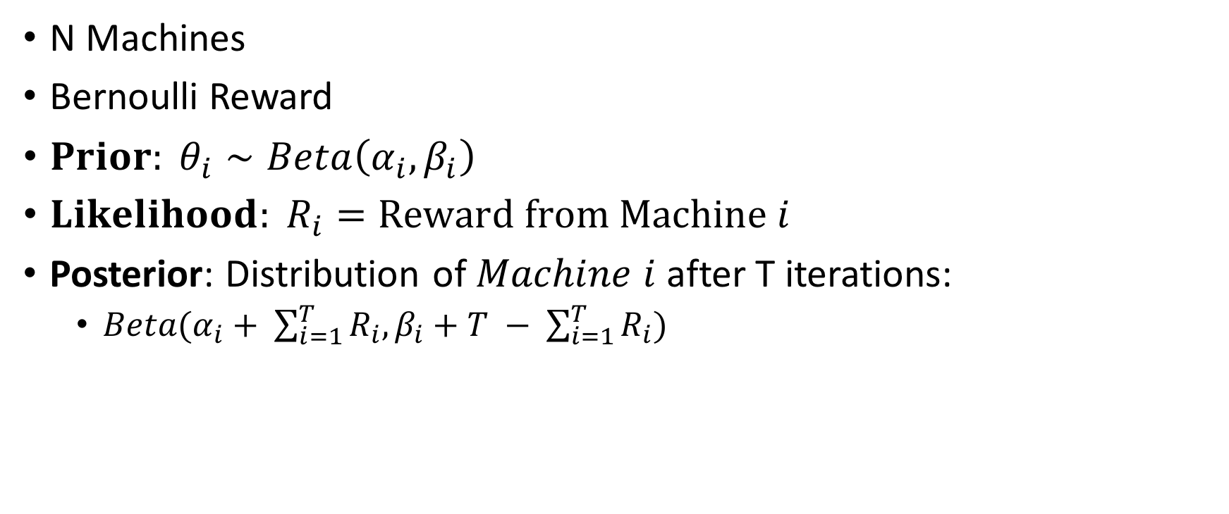
Bernoulli Bandit
😎
N Machines
Bernoulli Reward
${Prior: θ}_{i}∼Beta\left(α_{i}, β_{i}\right)$
${Likelihood: R}_{i}=Reward from Machine i$
Posterior: Distribution of $Machine i$ after T iterations:
$Beta(α_{i}+ \sum_{i=1}^{T}{R_{i}, β_{i}+T − \sum_{i=1}^{T}{R_{i}) } }$
😭

Slide 5
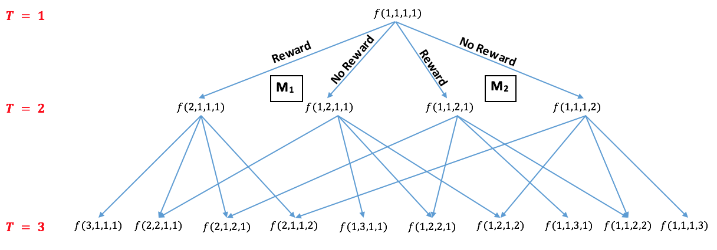
Dynamic Programming
Backwards Algorithm

Slide 6

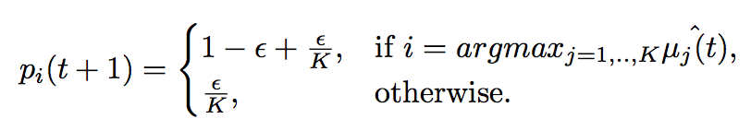
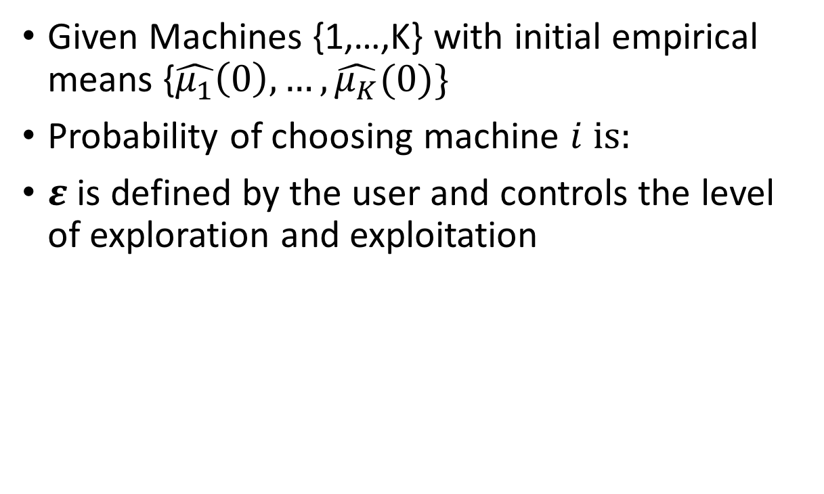
𝜺-Greedy
Given Machines {1,…,K} with initial empirical means {$\hat{μ_{1}}\left(0\right), …, \hat{μ_{K}}(0)\}$
Probability of choosing machine $i is:$
𝜺 is defined by the user and controls the level of exploration and exploitation

Slide 7
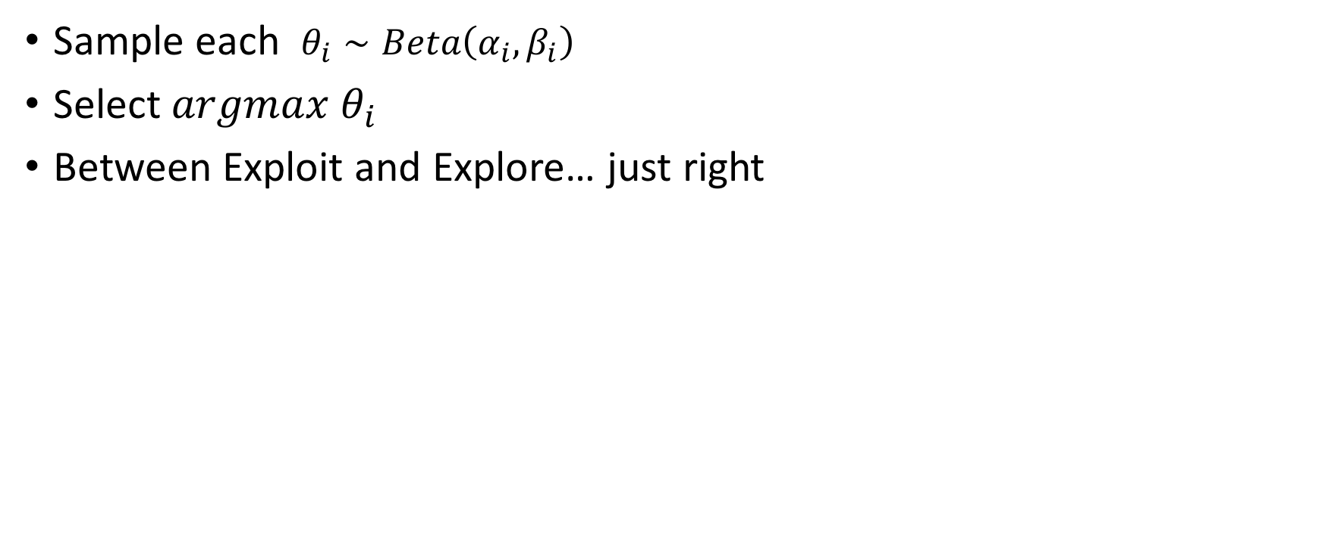
Thompson Sampling
Sample each $θ_{i}∼Beta\left(α_{i}, β_{i}\right)$
Select $argmax θ_{i}$
Between Exploit and Explore… just right

Slide 8
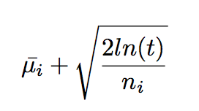
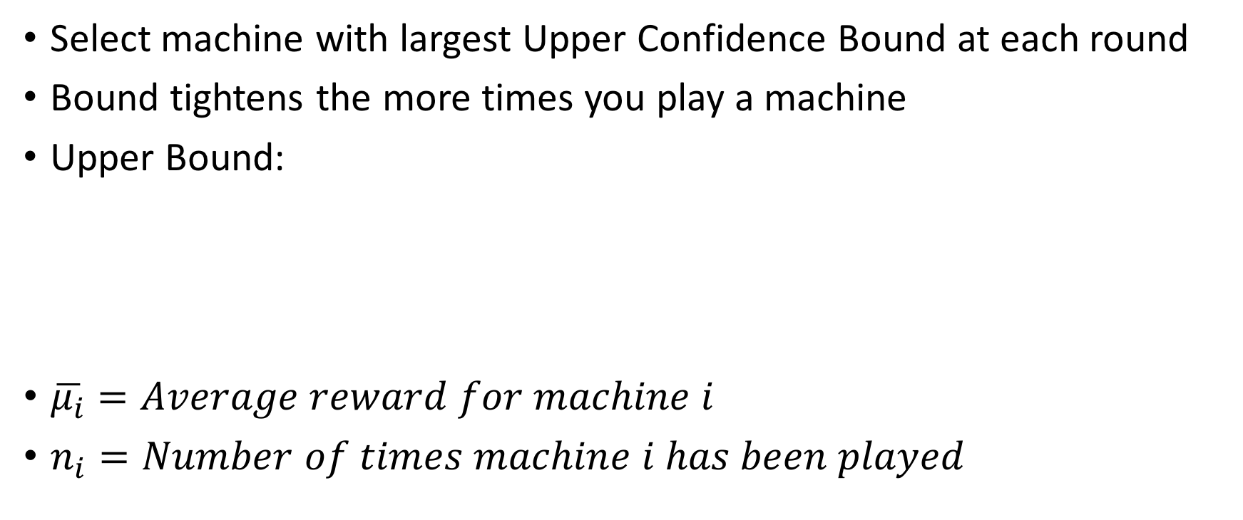
Upper Confidence Bound (UCB)
Select machine with largest Upper Confidence Bound at each round
Bound tightens the more times you play a machine
Upper Bound:
$\overline{μ_{i}}=Average reward for machine i$
$n_{i}=Number of times machine i has been played$

Slide 9
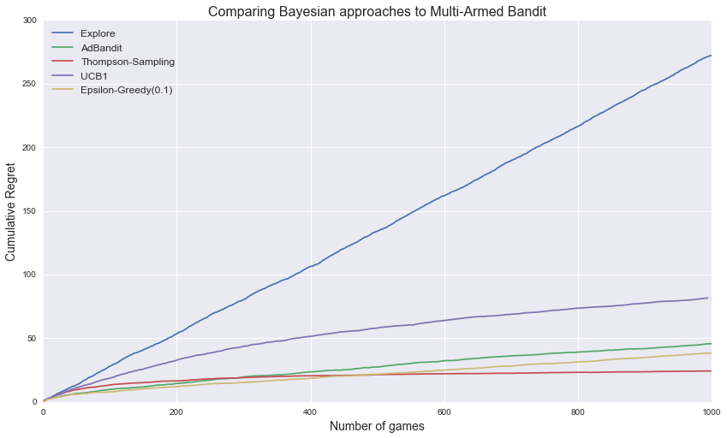

Slide 10
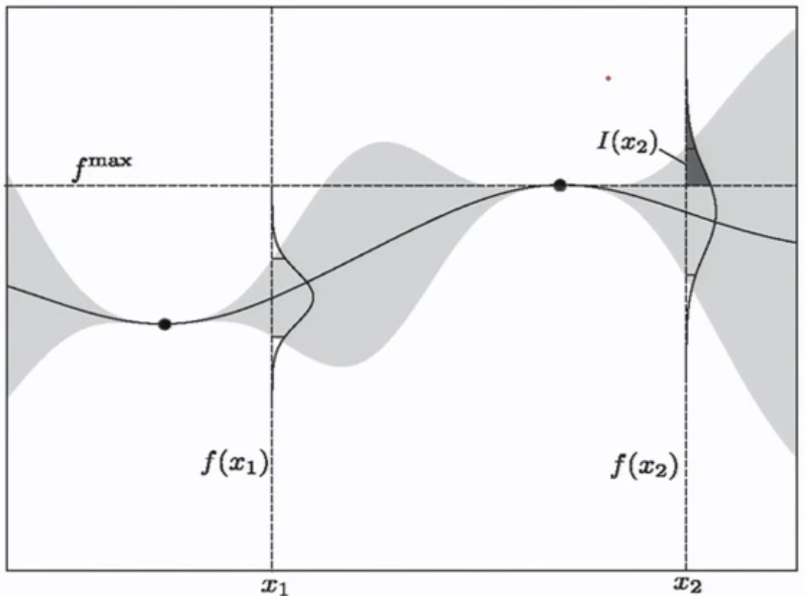
Gaussian Processes
Useful in continuous case!
Probability of Improvement (PI)

Slide 11
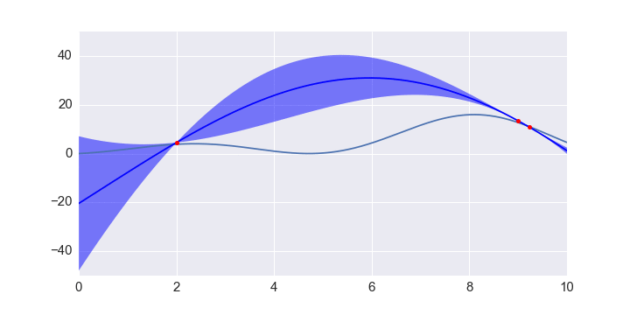
GP Fit Over Time

Slide 12
Slide References

